Slide 1
Policy Forum Luncheon
The State of U.S. Housing Supply: Hearing from Policy, Industry and Research Perspectives
Moderator: Gary Painter; University of Cincinnati
Panelist
Jenny Schuetz | Alex Baca | Caitlin Sugrue Walter | Troup Howard
Arnold Ventures | Greater Greater Washington | National Multifamily Housing Council (NMHC) | University of Utah

Slide 2
How can policy reforms unlock more housing capacity?
Jenny Schuetz
AREUEA National Meeting
May 2025
jschuetz@arnoldventures.org
@jenny_schuetz

Slide 3
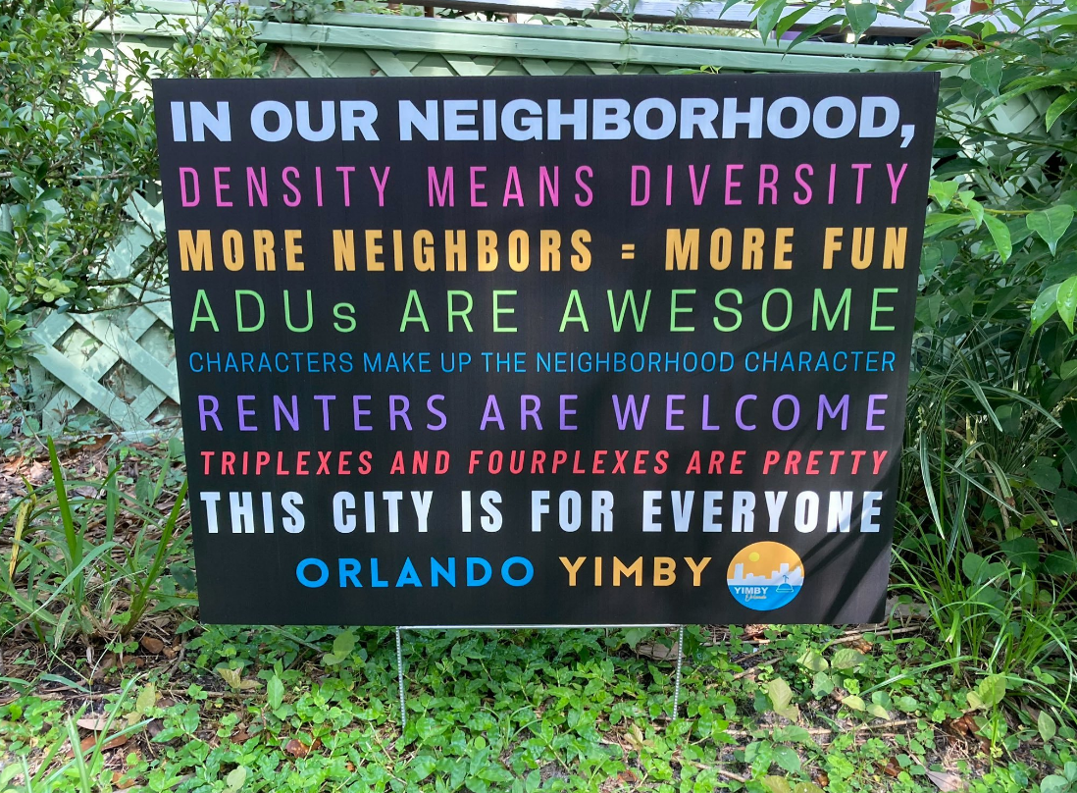
Notes:
Over past decade, huge increase in political salience of housing affordability, recognition that limited housing supply is a persistent problem.

Slide 4
Policy reforms to increase housing supply
Acknowledging the problem
Overly restrictive land use regulations make it hard to build housing in high-demand locations
Moving (slowly) towards solutions
What specific rule changes would effectively add housing capacity?
How can state govts nudge better local policies?
What research questions do policymakers need answered?
Notes:
Limited knowledge/understanding of zoning & development finance among state & local elected officials is a huge constraint. Even well-meaning legislators often don’t know the “right” policy changes to make.

Slide 5
20+ states have pro-housing policies

Slide 6
State-level pro-housing policies vary widely
Four general approaches to incentivize local govts to allow more development
State preemption of specific zoning rules
Oversight of local land use planning
Create “builders’ remedy” to override local zoning
Financial carrots and/or sticks tied to housing production
Policy design, implementation, & enforcement are complicated but important!
Notes:
Political considerations may constrain the most effective policy (e.g. big fiscal sticks targeted at expensive localities that fail to build housing may be harder to pass or to enforce than statewide legalization of ADUs).

Slide 7
Policy change has outpaced research
To date, few policy changes have been evaluated using rigorous research design
Have policies been effective in achieving direct goals (e.g., produced ADUs, apartments near transit)?
Good evaluation is hard!
Data gaps on production, selection bias, lengthy implementation, complex policy design…
But…policymakers need timely feedback on what works & what doesn’t
Thoughtful descriptive statistics soon are more useful than gold standard evaluations in 10 years.
Direct future advocacy efforts towards effective policies

Slide 8
Comments and questions welcome!
jschuetz@arnoldventures.org

Slide 9
Pro-housing advocacy in Washington, D.C.
Alex Baca, Greater Greater Washington AREUEA Policy Forum Panel
May 29, 2025

Slide 10
To advocate = to support
501(c)3
Blogging and thought leadership—we started as, and remain, ggwash.org
Relationship-building—we’re only as strong as our network
Organizing—basebuilding, turnout to public forums, civic engagement
Research—sometimes our own, but mostly employing others’
Events—fun!
501(c4)
Lobbying
Endorsements (of candidates and ballot measures)
GOTV for endorsed candidates
Political spending

Slide 11
How we use your research
In blog posts
In public testimony
In meetings with elected officials
To inform our candidate questionnaires
And more!
GGWash advocates for more housing, more affordable housing, frequent and reliable transportation, fewer trips by car, and fairer land-use practices in D.C., Maryland, and Virginia. Our relationships, and being perceived as competent actors in the local political landscape, is critical to our success.

Slide 12
Things decisionmakers tell me they want to know
Will building more housing impact X type of person?
Will building more housing increase property values?
Will building more housing decrease property values?
Will building more housing increase our tax base?
Will building more housing displace people?
Is this data disaggregated by race?
What will rents in [insert development project here] be?
What will [insert development project here] look like?
What does rezoning do?
Can it be 100 percent affordable?
The Height Act??????????
But it’s luxury housing (not a question, just a comment).

Slide 13
Things I want to know
How much housing needs to be built, and where, for housing costs in the District to be affordable to all residents at no more than 30 percent of their income?
What needs to be legal by-right to stimulate production of missing-middle housing (sixplexes+).
What kind of fiscal impact would legalizing multifamily housing District-wide have on our finances?
How greatly are our discretionary processes (via the Zoning Commission or the Board of Zoning Adjustment) impacting housing construction—what is the average time added to a project, and how much is it costing developers? What’s worse: Discretionary processes, or tenant protections?
Who supports increased housing production, but doesn’t go to public meetings to say so, but votes for local elected officials?

Slide 14
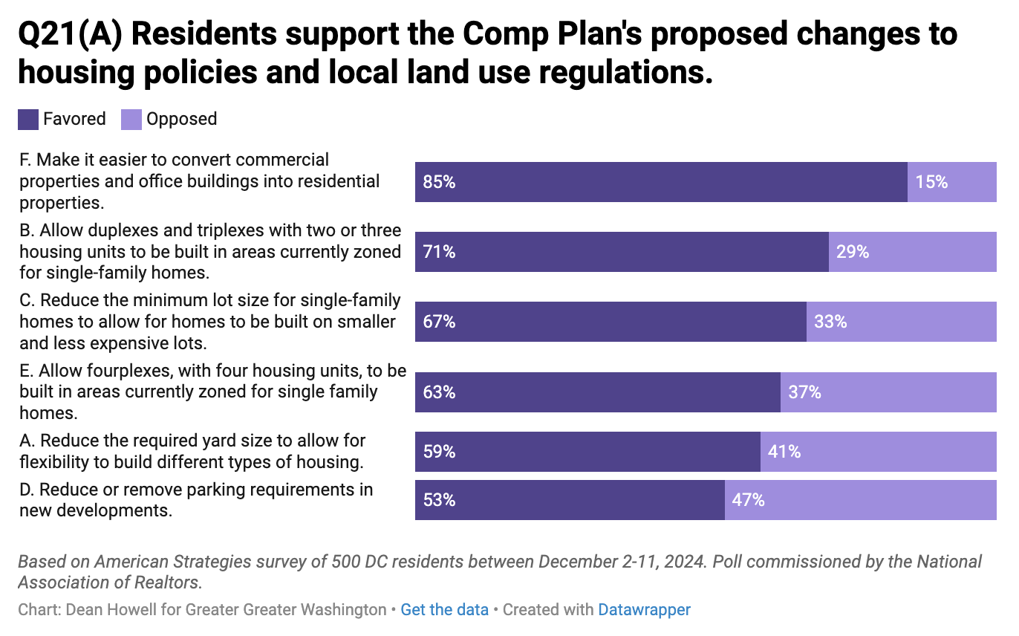
GGWash/GCAAR December 2024 poll of D.C. voters
“District residents prefer housing affordability to neighborhood character”!

Slide 16
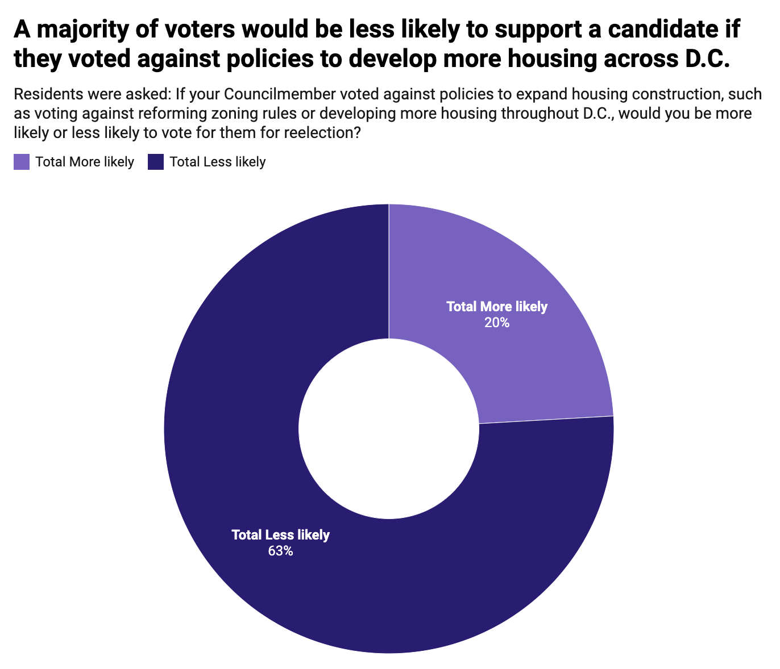

Slide 17
“Useful, but biased.” —A local elected official in Washington, D.C., describing GGWash.
Thank you!
Alex Baca abaca@ggwash.org ggwash.org

Slide 18
AREUEA Policy Presentation
Caitlin Sugrue Walter, Ph.D
May 29, 2025

Slide 19
Housing Provider Sentiments
Prevalence of NIMBY Opposition
Average impact when neighborhood opposition is present:
5.6% increase in
development costs
7.4 months delay
SOURCE: NMHC Quarterly Survey of Apartment Market Conditions

Slide 20
Housing Provider Sentiments
Avoidance of Jurisdictions with the Following Regulations:
Inclusionary Zoning
Rent Control
SOURCE: NMHC Quarterly Survey of Apartment Market Conditions

Slide 21
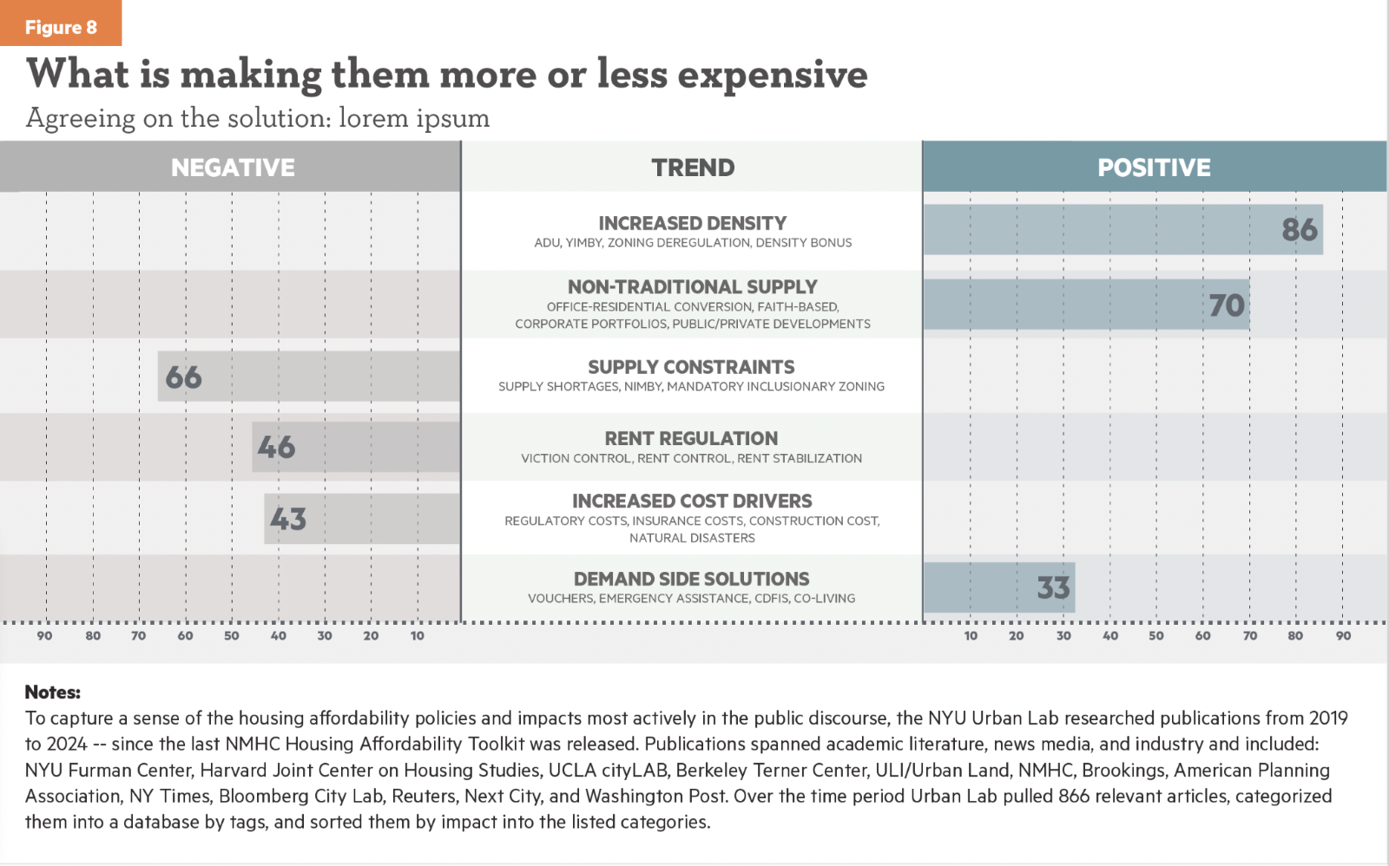
Translating Affordability Solutions to Policymakers & Media
SOURCE: Forthcoming NMHC Affordability Toolkit

Slide 22
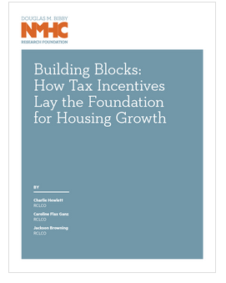
Develop Evidence-Based Solutions that Work for Everyone

Slide 23
Cracking Down, Pricing Up: Housing Supply in the Wake of Mass Deportation
Troup Howard | Mengqi Wang | Dayin Zhang
University of Utah | Amherst College | UW-Madison
AREUEA National
May 2025

Slide 24
Secure Communities Program
Motivation
Under SC: automatic information sharing between local law enforcement and DHS
↑↑ pr (deportation) pursuant to arrest for undocumented individuals
ICE attributes 25% of removals to SC: at scale ~80k/year
Approx 10-12 million people arrested each year
Staggered rollout due to resource/logistical constraints, 2008-2013
ICE assumption of custody requires transportation, bed space, meals
31,000 booking locations nationwide

Slide 25
Output: Reduced Flow of New Construction
Motivation
ACS Counties, Built Year
All Counties, Built Year
2000
2000
square feet per 1k pop
0
0
−2000
−2000
−4000
−4000
−6000
−6000
−4
−2 0
Year Since SC
2
−4
−2
0
2
Year Since SC
Cumulative effect, median county: Approx 500 fewer SFHs built

Slide 26
Impact: Increase in New Construction Prices
Motivation
All Counties, Raw Prices
All Counties, Quality Adjusted
log(market price)
0.2
0.2
0.1
0.1
0.0
0.0
−4
−2 0
Year Since SC
2
−4
−2
0
2
Year Since SC
Peak: quality-adjusted price increase of 18.5%

Slide 27
Motivation
Workforce: First Stage Impact
LEFB
2
0
−2
−4
−6
workers per 1k pop
−4
−2
Year Since SC
0
2

Slide 28
Workforce: Domestic Replacement Varies By Skill
Motivation
LEFB, Lower Skill
US−Born, Lower Skill
4
4
workers per 1k pop
2
2
0
0
−2
−2
−4
−4
−4
−2 0
Year Since SC
2
−4
−2 0
Year Since SC
2
Domestic replacement rate: 20-60% over three-year period

Slide 29
Workforce: Domestic Replacement Varies By Skill
Motivation
LEFB, Higher Skill
US−Born, Higher Skill
4
4
workers per 1k pop
2
2
0
0
−2
−2
−4
−4
−4
−2 0
Year Since SC
2
−4
−2 0
Year Since SC
2
Consistent with skilled labor being a compliment to less-skilled

Slide 30
Wages: Small Relative Increases
Motivation
RSMeans, Level
RSMeans, Relative
Relative Wage (to All Ind.)
0.10
0.10
Wage Index
0.05
0.05
0.00
0.00
−0.05
−0.05
−4
−2 0
Year Since SC
2
−4
−2 0
Year Since SC
2

Slide 31
Policy Forum Luncheon
The State of U.S. Housing Supply: Hearing from Policy, Industry and Research Perspectives
Q & A

